Slide 1
Tutorial
Management
Presented by Group 1

Slide 2
Table of contents
01
02
03
04
Introduction
Features
Tools &
Technology Used
05
06
Dependencies
Schemas,
Structure &
Relationship
Controllers

Slide 3
01
Introduction

Slide 4
Tutorial management system is the platform where users can upload tutorials in theoretical form.
It is the best platform where the user can upload study material or other type of tutorials for better, easy and line by line accessibility of content to user.
Not only uploading but also a most important feature is that the user which are reading or studying that particular tutorial can easily give their feedback in the form of comments below that particular section.

Slide 5
02
Features

Slide 6
Create Tutorial
Update Tutorial by id
Delete Tutorial by id
Delete Tutorial all at once
Get Tutorial by id
Get tutorial by published
Get tutorial by tittle
Create Comment
Update Comment by id
Delete Comment by Tutorial id
Delete Comment by id
Get Comment by id
Get Comment by Tutorial Id

Slide 7
03
Tools and Technology Used

Slide 8
Spring Boot
JDK
Rest API
Maven
Spring Data JPA
IDE - Eclipse
PostgreSQL
Swagger

Slide 9
04
Dependencies

Slide 10
Spring Web
JPA
Devtools
PostgreSQL
Springdoc-openapi-ui ( for Swagger )

Slide 11
05
Schemas,
Structure &
Relationship

Slide 12
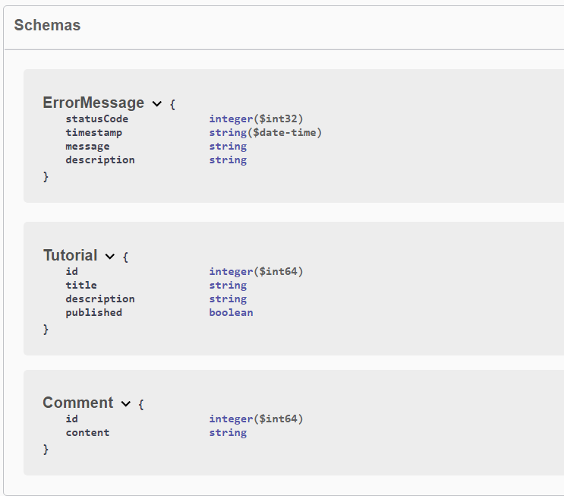

Slide 13
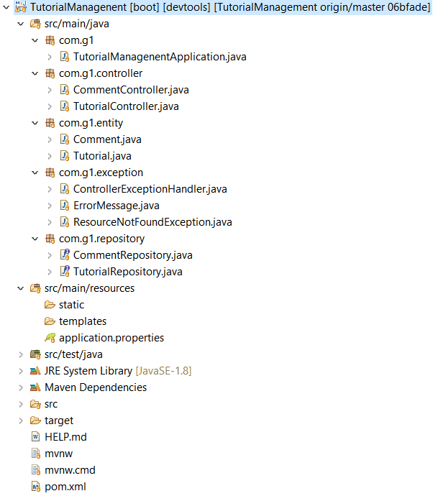

Slide 14
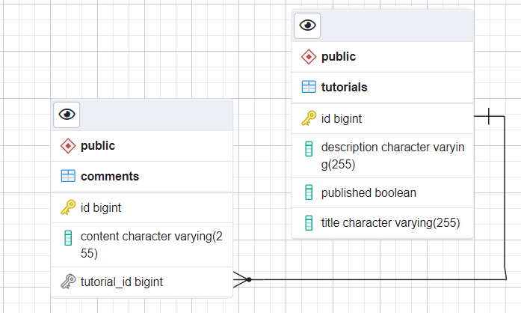

Slide 15
06
Controllers

Slide 16
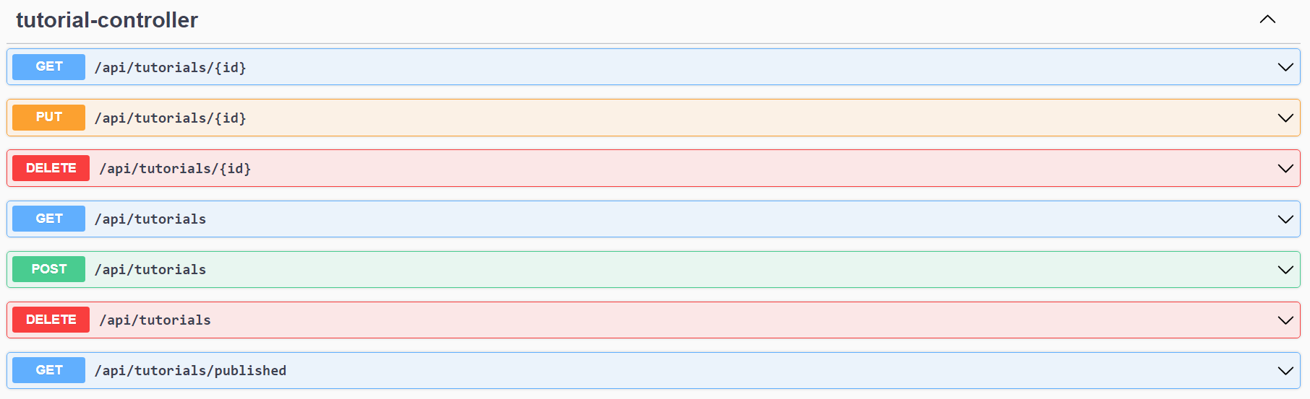

Slide 17
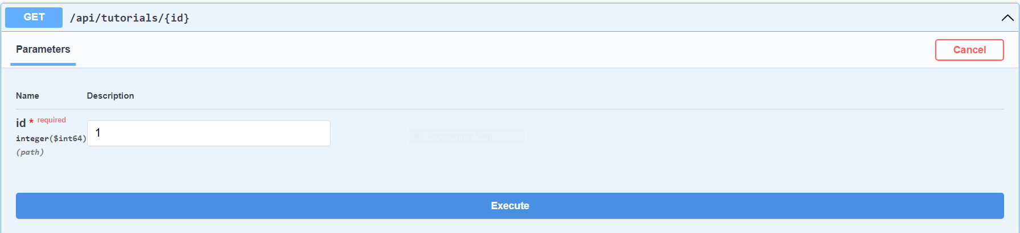

Slide 18
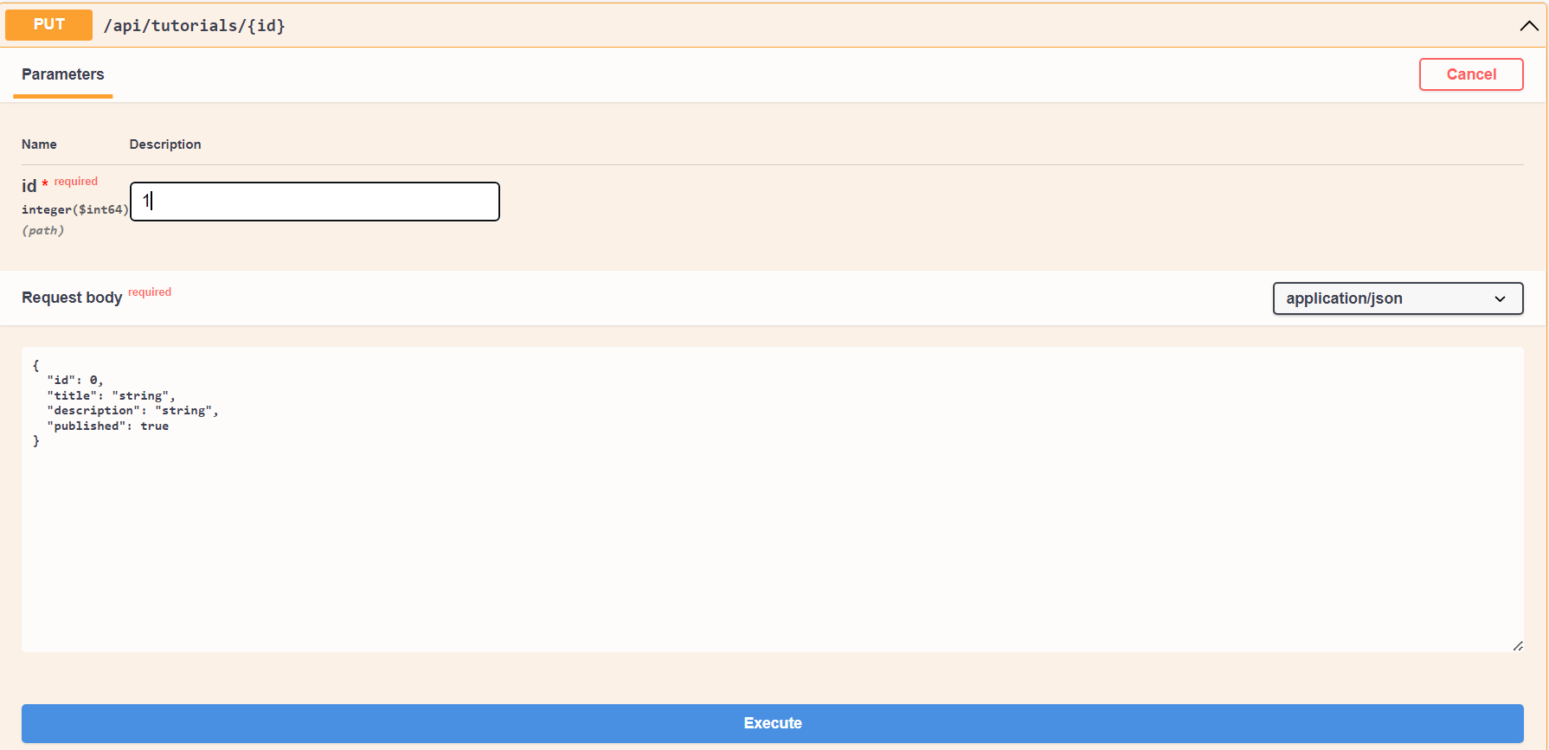

Slide 19
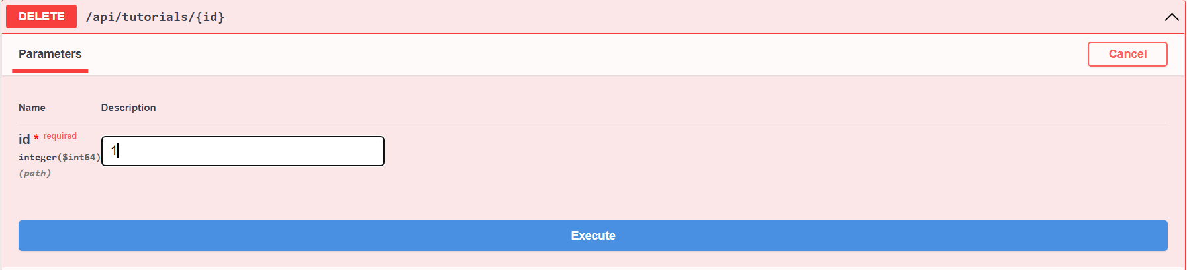

Slide 20
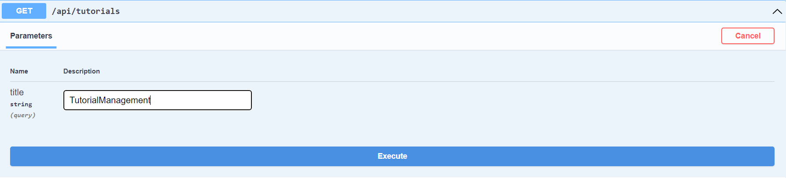

Slide 21
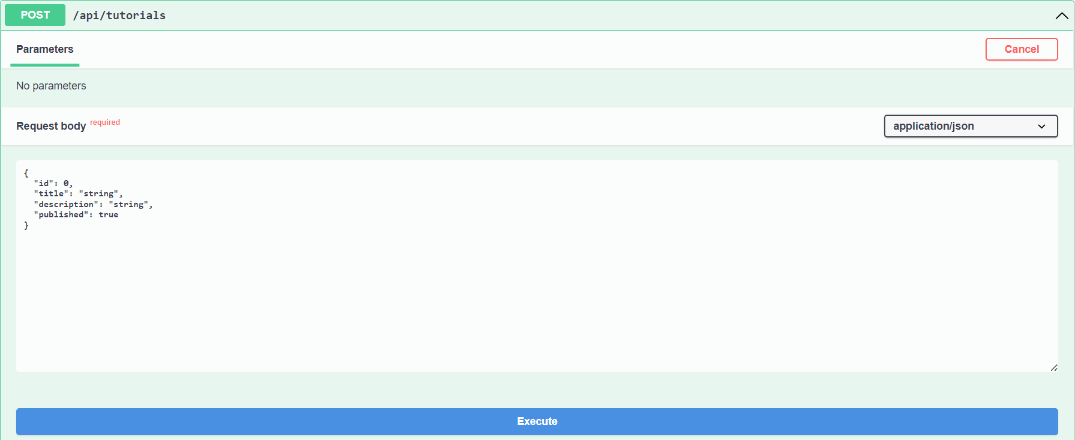

Slide 22
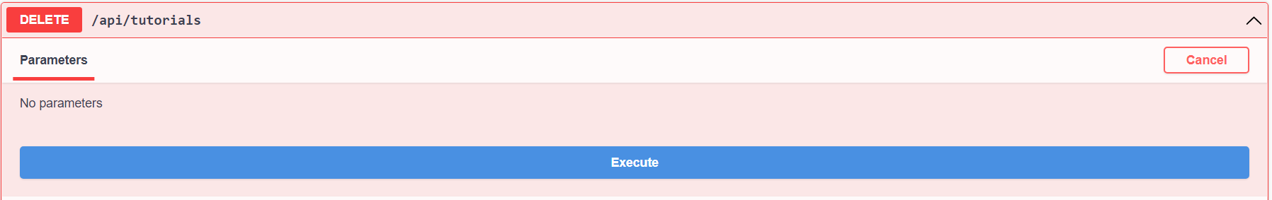

Slide 23
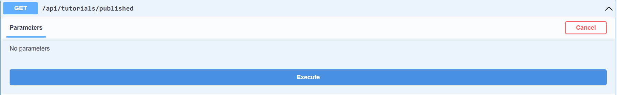

Slide 24
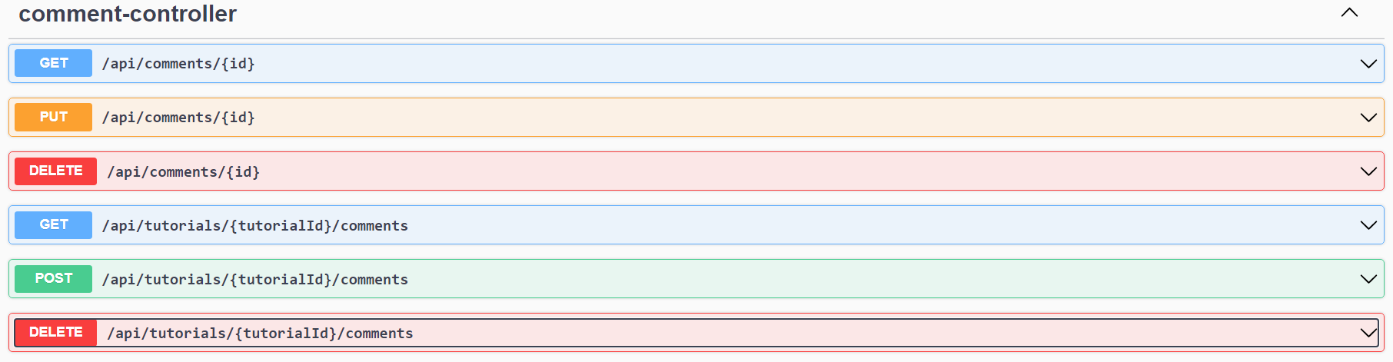

Slide 25
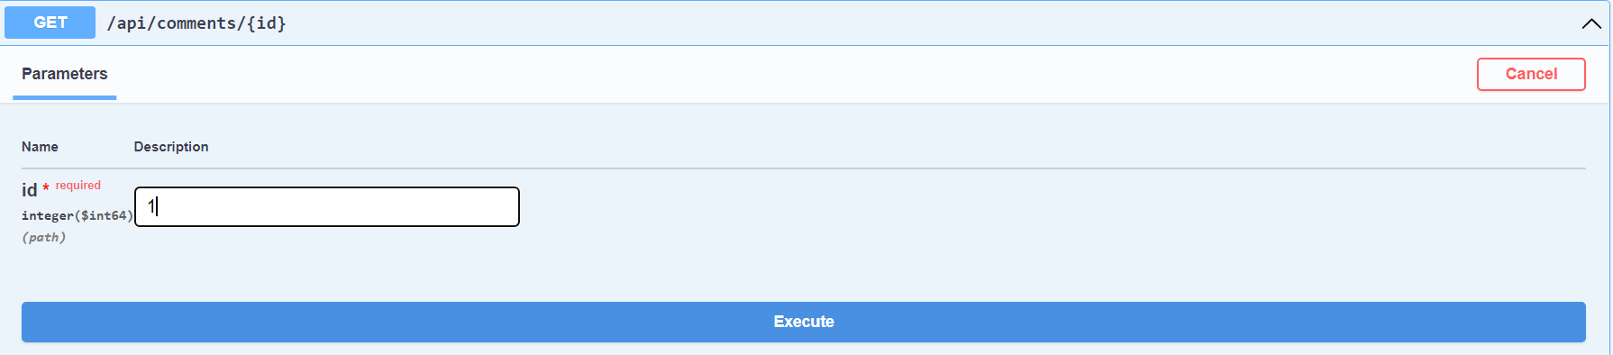

Slide 26
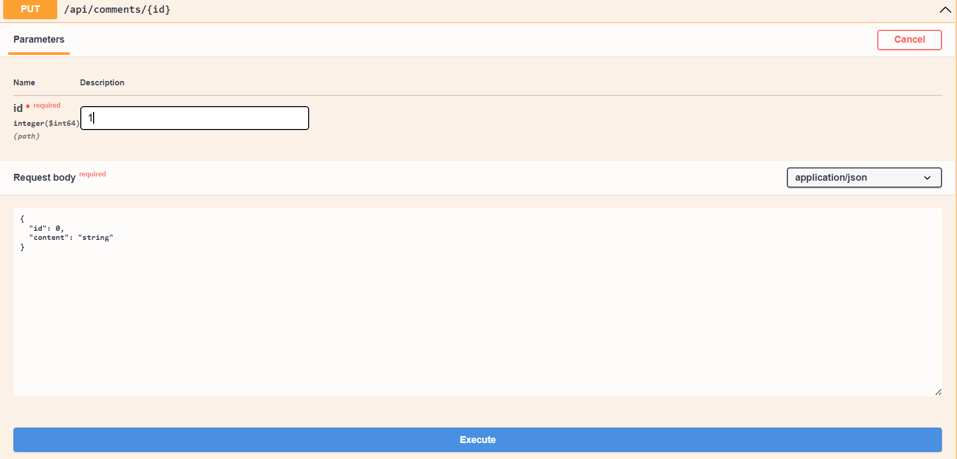

Slide 27
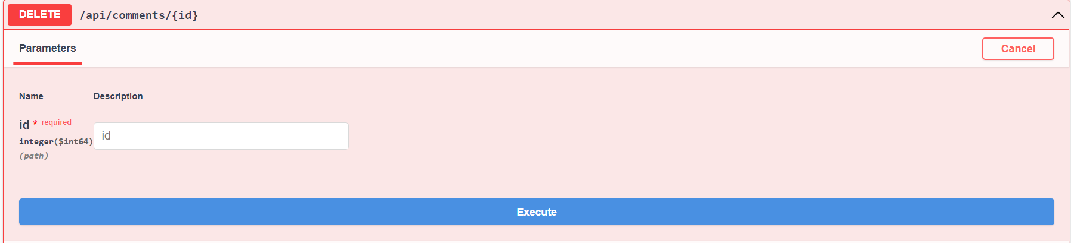

Slide 28
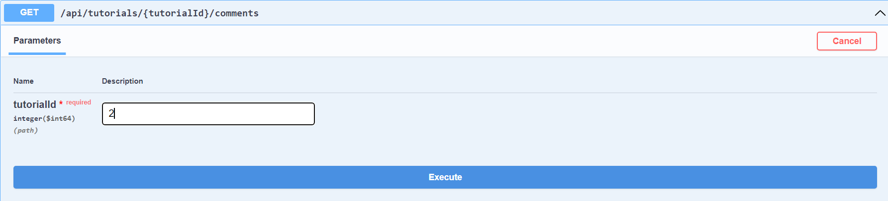

Slide 29
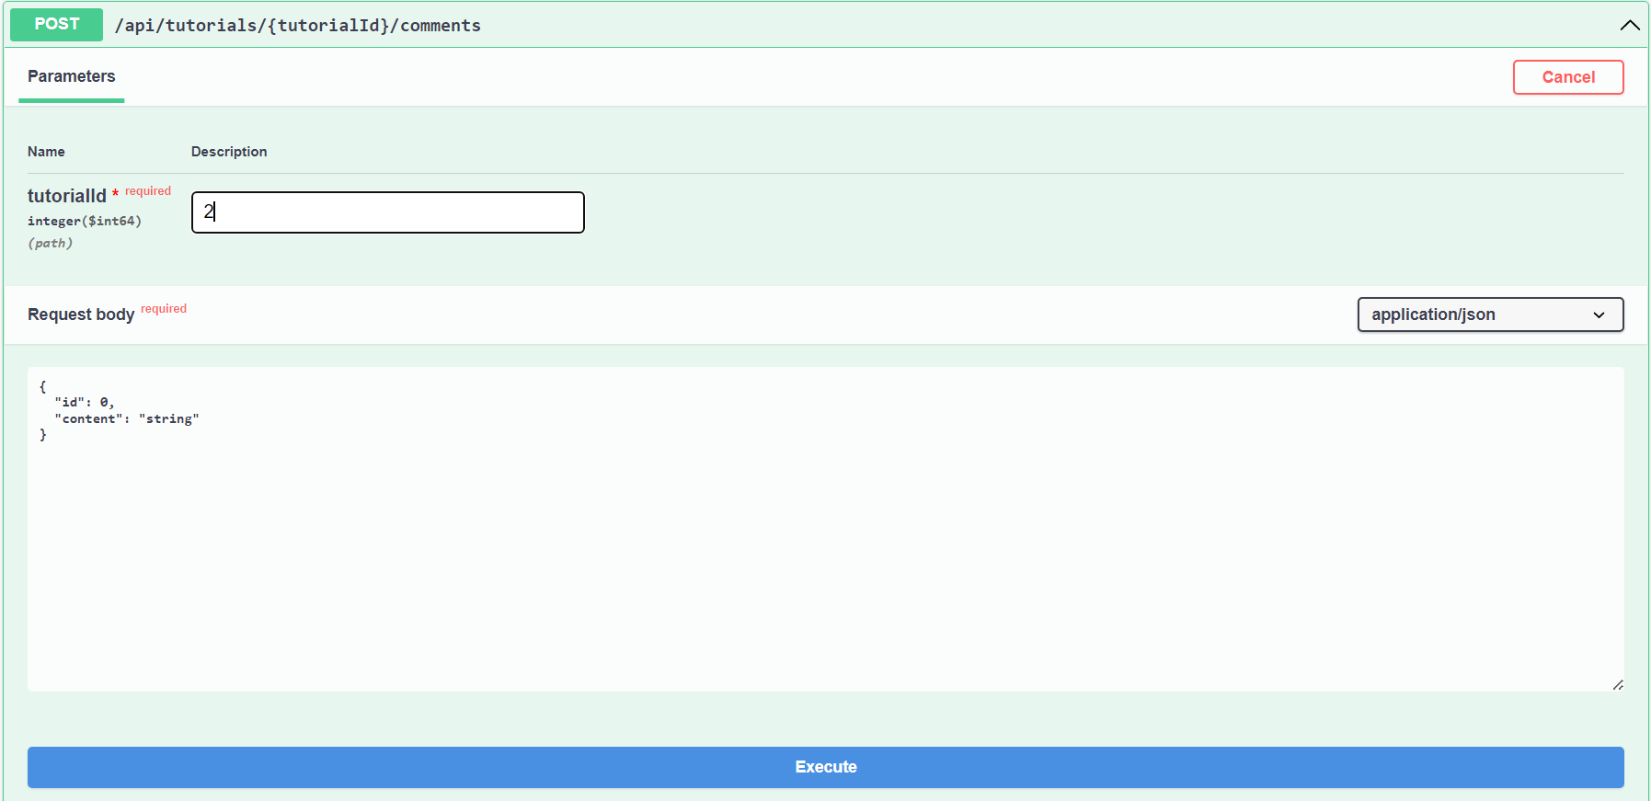

Slide 30
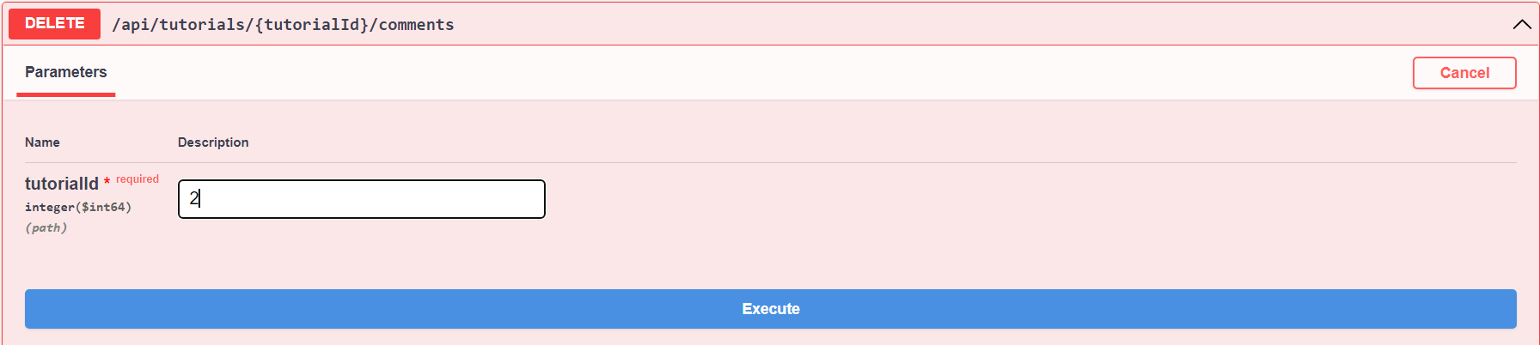

Slide 31


